Slide 1




Automated Forklift
for Enhanced Material Handling
Paper ID - 28
ABHINAND BINU
RAJADHANI INSTITUTE OF ENGINEERING & TECHNOLOGY

Slide 2
lIST OF CONTENT
Introduction
Literature Review
Problem Statement
Objectives
Methodology
Results
Conclusion
Future Scope
References

Slide 3
ABSTRACT
Efficient material handling is a critical component of modern industrial operations, directly impacting productivity and safety. This paper presents the design and development of an automated forklift system designed to enhance material handling processes in industrial environments. The system utilizes a combination of infrared (IR) sensors for obstacle detection and navigation, along with an Arduino Uno board for control logic. The forklift is equipped with Bluetooth functionality, enabling remote operation and seamless integration with existing industrial automation systems. The proposed system aims to improve operational efficiency, reduce human error, and enhance workplace safety by automating repetitive material handling tasks. Experimental results demonstrate the system's ability to navigate autonomously, avoid obstacles, and perform precise material handling operations. This innovation has the potential to significantly contribute to the optimization of industrial workflows and the adoption of Industry 4.0 principles.

Slide 4
INTRODUCTION
Importance of efficient material handling in industries
Challenges in manual forklift operation (safety, efficiency, labor cost)
Need for automation in material handling

Slide 5
LITERATURE REVIEW
Design and Development of an Automated Forklift with IoT Weight System (Jagadeesh et al., 2024): This study focuses on automating forklifts with IoT-enabled weight measurement and RFID-based pallet identification. It highlights the effectiveness of IR sensors for navigation and obstacle avoidance in industrial environments.
Autonomous Counterbalance Forklift (KTH Royal Institute of Technology, 2019): This research explores line-following technology for forklift automation. An Arduino Uno was used for control, while IR sensors ensured precise movement and obstacle detection.

Slide 6
Fabrication of Automatic Forklift Design for Robotic Material Handling (IJIRMF, 2019): This paper discusses the development of an automatic forklift using IR sensors and a black line sensing system for material handling, enhancing accuracy and efficiency in warehouse operations.
Development of Unmanned Guided Vehicle for Material Handling (IJRTE, 2019): This research presents an Arduino-based unmanned guided vehicle (UGV) that automates material handling, reducing human intervention and improving safety in industrial environments.

Slide 7
PROBLEM STATEMENT
Traditional forklifts rely heavily on human operators, leading to inefficiencies, safety risks, and increased labor costs.
Manual operation introduces errors in material handling, delays, and potential accidents in industrial settings.
A lack of automation hinders seamless integration with Industry 4.0 technologies.
There is a growing need for an intelligent, automated forklift system that minimizes human intervention while improving accuracy and workplace safety.

Slide 8
OBJECTIVE
Develop an automated forklift system for industrial use
Implement IR sensors for obstacle detection and navigation
Use Arduino for system control
Integrate Bluetooth for remote operation
Enhance safety and efficiency in material handling

Slide 9
methodology
1 SYSTEM DESIGN
MECHANICAL DESIGN
ELECTRICAL DESIGN

Slide 10
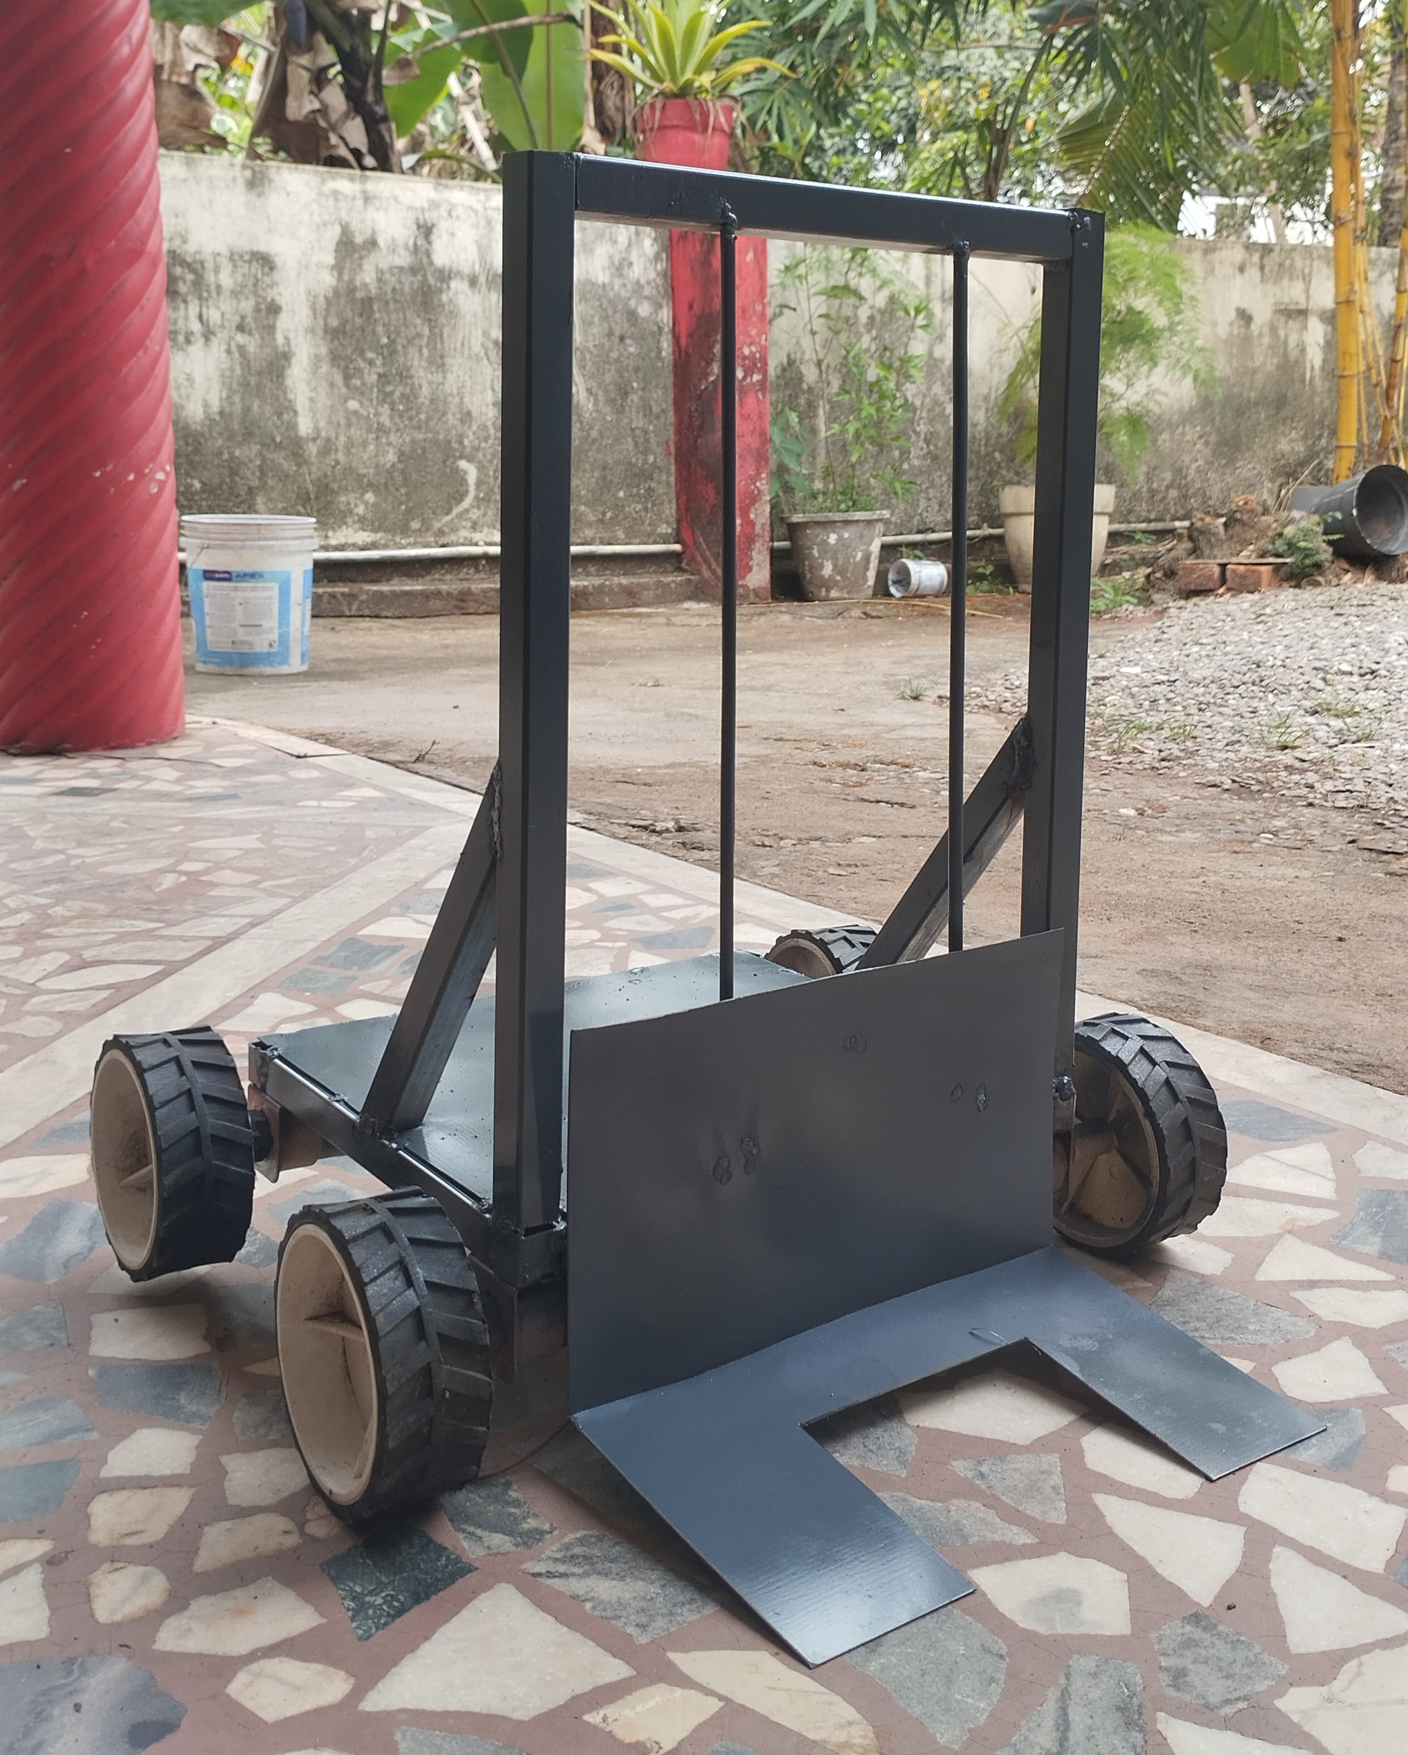
MECHANICAL DESIGN
Frame structure (metal chassis).
Wheel & motor selection.
Fork lifting system.

Slide 11
ELECTRICAL DESIGN
Microcontroller: Arduino (e.g., Arduino Mega).
IR Sensors – Line following & obstacle detection.
Ultrasonic Sensors – Distance measurement.
Motor Drivers & Actuators: For lifting

Slide 12
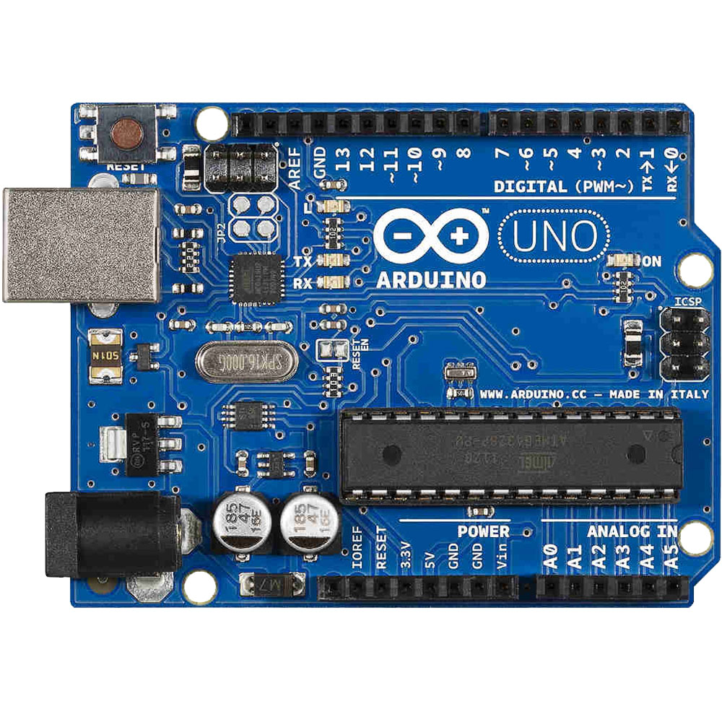
COMPONENTS USED
Microcontroller: Arduino Uno
Arduino is an open-source electronics platform based on easy-to-use hardware and software. Arduino boards are able to read inputs - light on a sensor, a finger on a button, or a Twitter message - and turn it into an output - activating a motor, turning on an LED, publishing something online. You can tell your board what to do by sending a set of instructions to the microcontroller on the board.

Slide 13
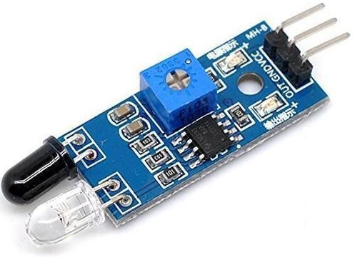
Sensors: IR sensors for LINE FOLLOWING
IR technology is used in a wide range of wireless applications which includes remote controls and sensing. The infrared part in the electromagnetic spectrum can be separated into three main regions: near IR, mid-IR & far IR. The wavelengths of these three regions vary based on the application. For the near IR region, the wavelength ranges from 700 nm- 1400 nm, the wavelength of the mid-IR region ranges from 1400 nm – 3000 nm & finally for the far IR region, the wavelength ranges from 3000 nm – 1 mm.

Slide 14
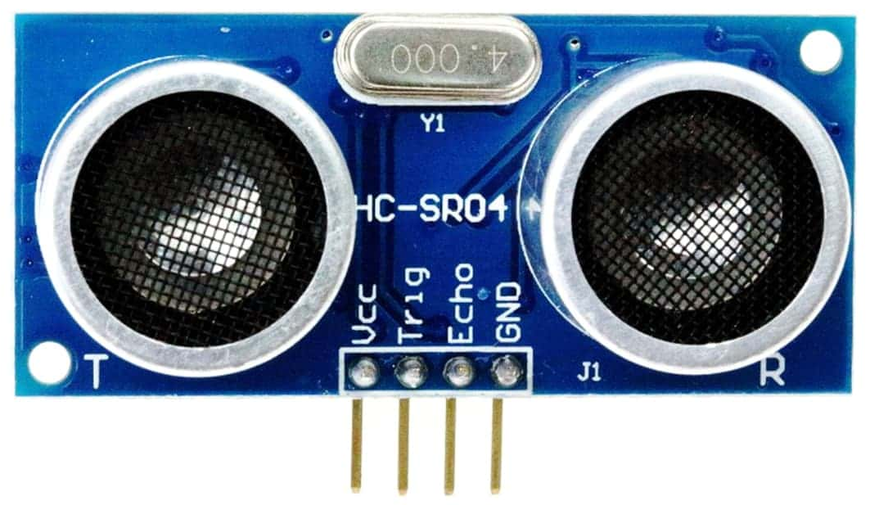
uLTRA SONIC sensor: FOR OBSTACLE AVOIDANCE
The ultrasonic sensor is a key component in the
automated forklift project, enabling obstacle detection
& distance measurement. It works by emitting high-frequency ultrasonic waves & measuring the time taken for the echo to return, calculating the distance based on the speed of sound. In this project, it helps in preventing collisions, ensuring safe navigation, and assisting in fork height adjustment when handling materials. The HC-SR04 sensor, commonly used with Arduino, provides accurate readings for real-time decision-making. Its low-cost, reliability, and ability to function in various lighting conditions make it an ideal choice for warehouse automation.

Slide 15
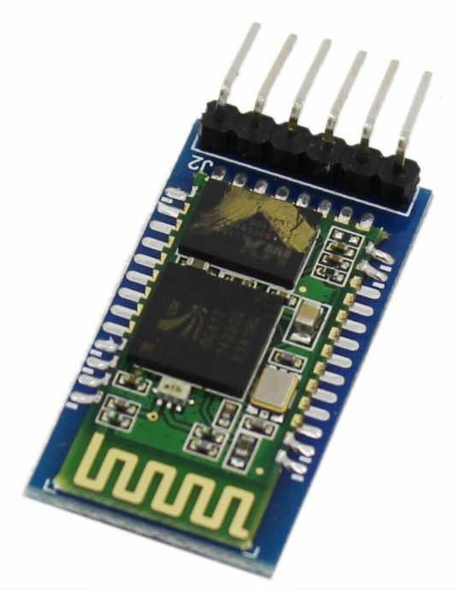
Communication Module: Bluetooth for remote control
A Bluetooth module is a specialized chip that is designed to wirelessly connect two compatible devices for communication, and it does it using its low energy wave feature.
These modules act as the interface between the microcontroller and the devices. The scope of these modules is not just limited to smartphones and laptops but also includes multiple types of devices, such as watches and households that use Bluetooth modules to share data.

Slide 16
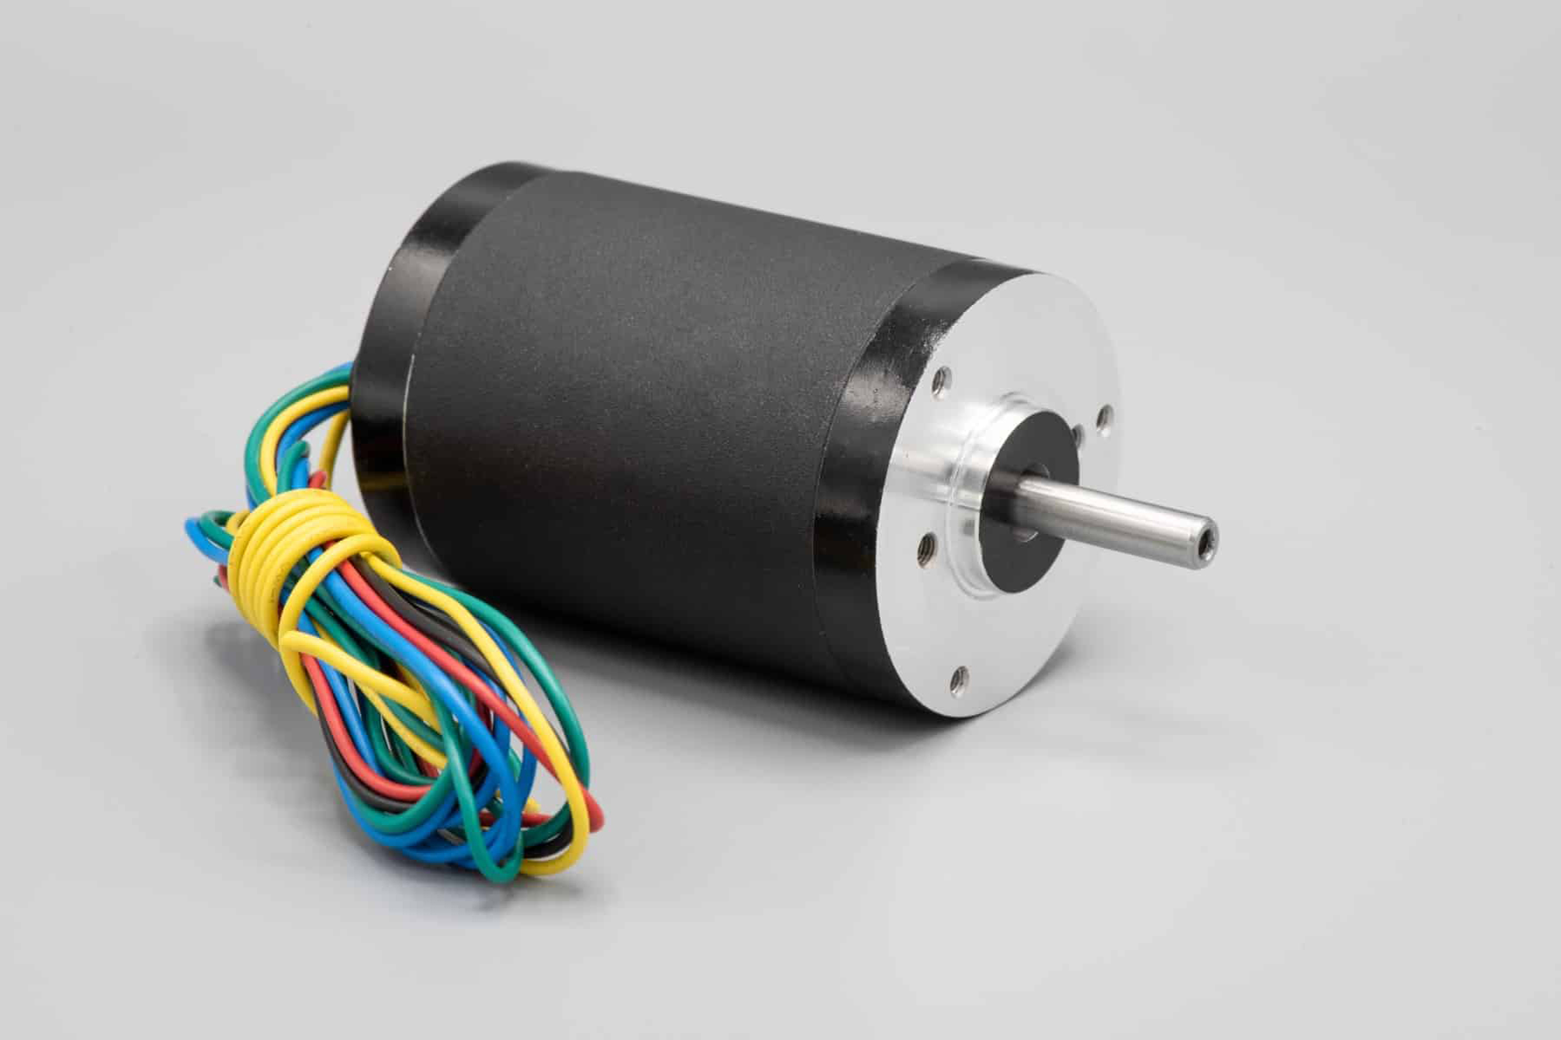
Motors: DC motors for movement and lifting
DC motor is a machine that converts electrical energy of direct current into mechanical energy. In a DC motor, the input electrical energy is direct current which is converted into mechanical rotation.
It is based on electromagnetic induction, where a conductor carrying current (normally a coil of wire) placed in a magnetic field experiences force to rotate. This rotation is used to perform mechanical work.

Slide 17
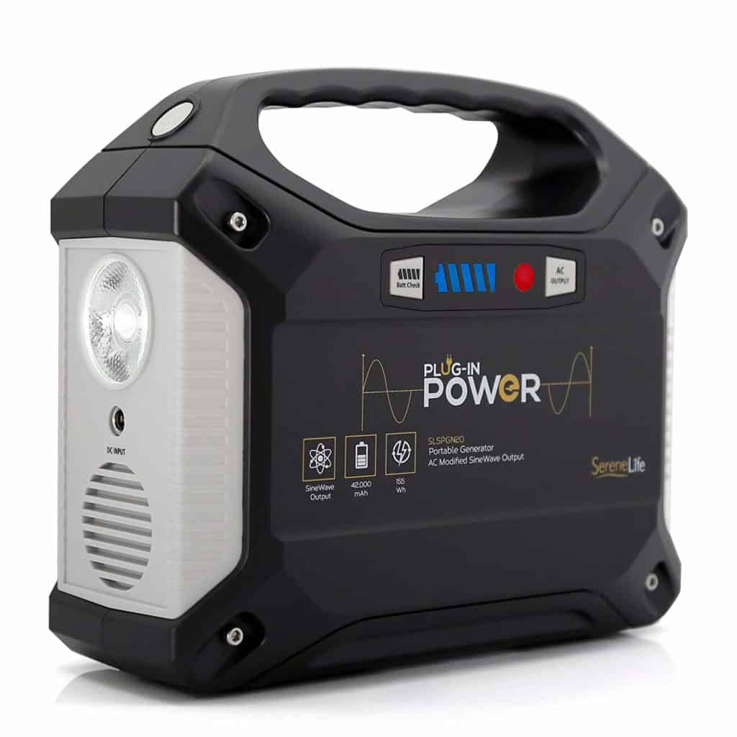
Power Supply: Rechargeable battery

Slide 18
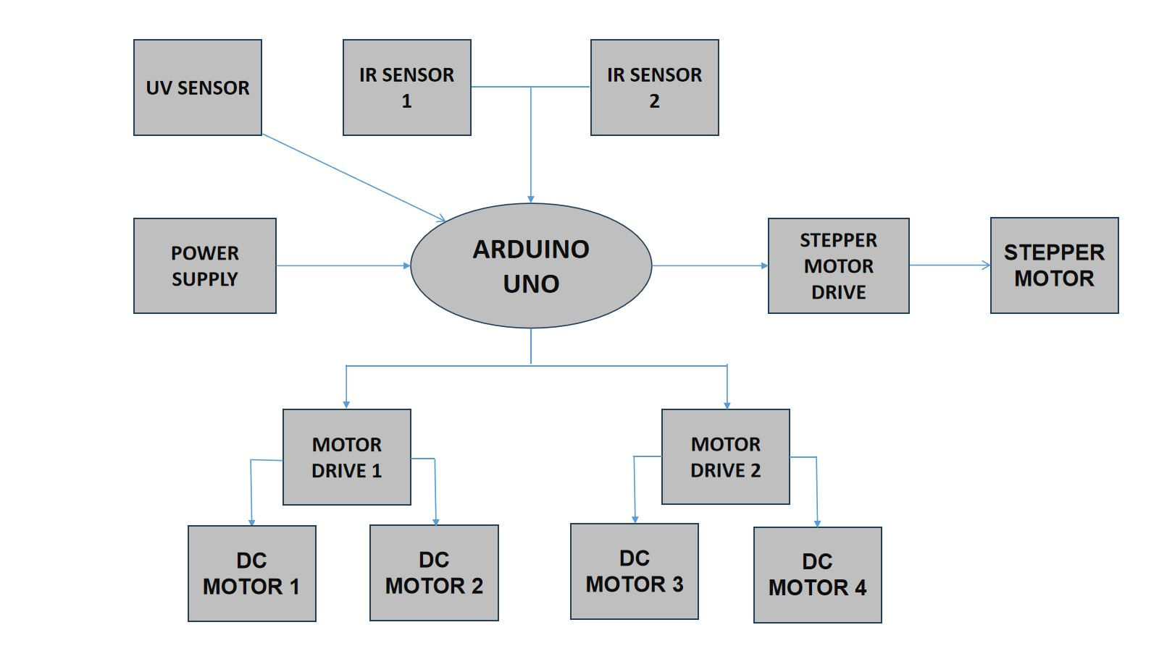
BLOCK DIAGRAM

Slide 19
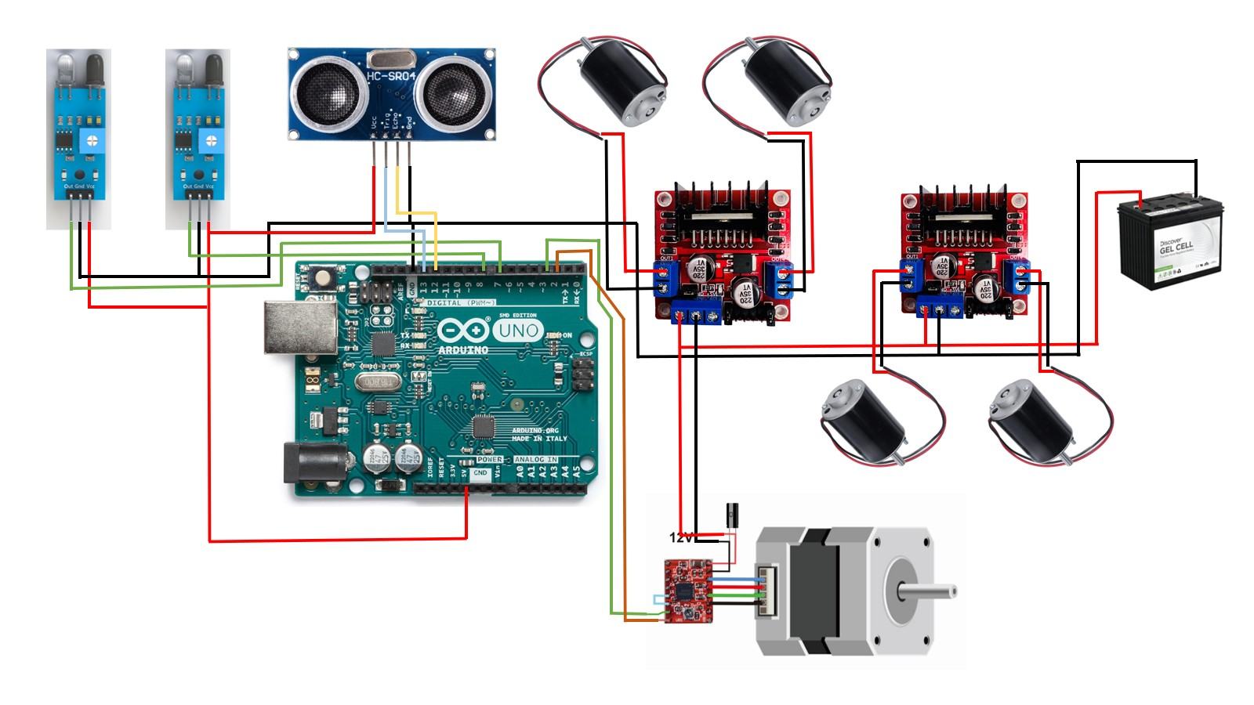
CIRCUIT DIAGRAM

Slide 20
RESULT
Successfully built a working prototype of an automated forklift.
Integrated IR sensors for path-following and obstacle detection.
Implemented Arduino-based control for precise movement and lifting.

Slide 21
CONCLUsION
The Automated Forklift for Enhanced Material Handling successfully demonstrates the potential of automation in industrial environments. By integrating IR sensors for obstacle detection, Arduino-based control, and Bluetooth for remote operation, the system improves efficiency, safety, and precision in material handling.
The experimental results validate the forklift’s ability to navigate autonomously, detect obstacles, and perform lifting operations with minimal human intervention. This project contributes to the advancement of Industry 4.0, supporting smart warehouse and factory automation trends.

Slide 22
FUTURE SCOPE
AI Integration for adaptive navigation and path planning
IoT Connectivity for real-time monitoring and analytics
Advanced Sensors (LiDAR, Ultrasonic) for improved obstacle detection
Enhanced Load Capacity & Speed Optimization for better performance

Slide 23
REFERENCE
1.Smith, J., et al. (2021). "Infrared Sensors in Warehouse Robotics." IEEE Transactions on Industrial Electronics.
2.Kumar, R. (2020). "Arduino-Driven Automation for SMEs." Springer Robotics Series.
3.Lee, S. (2022). "Bluetooth-Enabled Industrial IoT Systems." Sensors.
4.Patel, H., et al. (2021). "Sensor Fusion for Dynamic Environments." Robotics and Computer-Integrated Manufacturing.
5.Author, W. S. (2019). "Distance Measurement Using IR Sensors." Journal of Automation and Control Engineering.

